Slide 1

Fitness club management system
Under the supervision of
Dr . Mamdouh Gomaa
Eng . Samah Essam

Slide 2

Team Member
Mikhail emad alber 20-00682
Kerolos nabil fahmy 20-00632
Mohammed ezat Mahmoud 20-01255
micheal aiman 1900076
Micheal Badry Naiem 20-00888
Mohammed hassan gamal 20-00886
Mina Medhat Abouelghit2000826

Slide 3

Agenda
Introduction
Motivation
Related Work comparison
Problem Statement
Solve problem
services
System Architecture
Demo
System Tools & Technologies
References
Conclusion

Slide 4

Introduction

Slide 5
Introduction
The Fitness Club Gym Web Application is a platform designed for fitness management
The application is accessible from anywhere with an internet connection, allowing users to manage their fitness journey.
The application is designed to cater to both gym members and administrators.
Members can easily book personal trainers.

Slide 6
Introduction
The Fitness Club Gym Web Application It is built using modern web technologies such as HTML, CSS, JavaScript, BootStrap, PHP, and MySQL to create a seamless fitness management experience.
providing personal trainers booking, membership plans, an online store, BMI/BMR calculators, workout plans, and nutritional guidance in one platform.

Slide 7
Motivation
Our Fitness Club Gym Web Application providing many services in one place
other than private coaches with good experience to help you get fit there are diet plans if you are too busy and can't workout
using our BMR system you can know how many calories you need on daily basis and you can find our recipes with all details you need and the calories in each recipe, also if you are not busy and want to go to the gym and improve your workout our website provides supplements, straps, gym outfits everything you need for your gym
Providing an all-in-one platform for fitness

Slide 8
Related work Comparison

Slide 9
Related work Comparison
Feature | Gold’s Gym | EQUINOX | الكوتش | Muscle And Strength | Centr Fitness App | Lose Weight App | Our Application
AI-Features | ❌ | ❌ | ❌ | ❌ | ❌ | ❌ | ✅
Personal Training | ✅ | ✅ | ✅ | ❌ | ✅ | ❌ | ✅
Workout Plan | ✅ | ✅ | ✅ | ✅ | ✅ | ✅ | ✅
Nutrition Plan | ❌ | ❌ | ✅ | ✅ | ✅ | ❌ | ✅
Online Shop | ✅ | ✅ | ❌ | ✅ | ✅ | ❌ | ✅
TRX | ❌ | ❌ | ❌ | ❌ | ❌ | ❌ | ✅

Slide 10
Problem statement

Slide 11
Problem Statement
The problem is there is no web application that provides many services in on place to make it easier for clients and help them in their fitness journey and no application supporting a with AI-Features to help user To get better performance.

Slide 12
Solve Problem

Slide 13
Solve Problem
Develop an all-in-one fitness web application that consolidates essential services—such as personalized workout plans, nutrition plan , trainer booking, and The application will have AI features to provide BMR, all of this to support users in achieving better results more efficiently.

Slide 14
services

Slide 15

services
Nutrition
Recipes
Workout Plan
TRX
BMR
Online Store
Personal Training
Booking system

Slide 16
Nutrition
A Nutrition Plan is a structured guide for what, when, and how much to eat to meet specific health or fitness goals like weight loss, muscle gain, better energy, or managing conditions like diabetes.
It’s important to track your goal in fitness.

Slide 17
Recipes
The page is a health and nutrition website that provides a comprehensive guide to various recipes plans, including weight loss, weight gain, and weight stabilization. It features healthy recipes, meal plans, and nutritional advice designed to help users achieve their health goals.

Slide 18
Workout Plan
The Workout plan provide users a categorized, image-rich overview of key strength training movements , and provide catalog of strength training exercises, categorized by major muscle groups, enabling individuals of all fitness levels to better understand effective workout techniques, To choose the appropriate exercise.

Slide 19
TRX
TRX : A full-body workout system using only body weight for Builds strength, balance, and endurance
Perfect for both beginners and athletes
We have an exercise plan with pictures and videos that show how to perform the exercises correctly to Train anywhere from home, gym, or outdoors.

Slide 20
BMR
BMR (Basal Metabolic Rate) It is the number of calories your body needs
It’s important for :
Plan an accurate calorie intake for weight loss, gain, or maintenance Understand how your body burns energy
Build personalized nutrition plan and fitness programs
It use weight, height, age and gender to calculate the BMR.

Slide 21
Personal Training page
The "Personal Trainers" page is a dedicated section within the sports club application that displays available trainers along with their expertise, skills, and specialties. It serves as a bridge between members and trainers, helping users choose the right coach based on their fitness goals

Slide 22
Booking system
It is a system that allows the user to book a specific trainer to train with.
This is divided into two interfaces, one at the user interface and the other at the trainer interface.

Slide 23
Booking system user interface
On this page the user can see the trainers, their specialties and their hours of presence in the club to book with them.

Slide 24
Booking system trainer interface
Book page:
On this page, coaches can see the users they have booked with.
profile page:
On this page, trainers can edit their data that appears to the user on the booking page, such as their specialization, photo, description, and hours of presence in the club.

Slide 25
Online Store
The online store is a feature available for all users to access and buy the items they need in their workout it targets all people who are interested in fitness lifestyle helping them to achieve their goal
Cart : to remove or edit quantity of the product
Payment : To complete purchases

Slide 26
Online Store Order Management
It’s a part of the admin and private coach(sub admin)’s dashboard enable them in a simple way to manage the orders and change the status of the order when it’s delivered and help them to check the total amount the user paid in case of cancelling the order and a delete button to delete the old orders to not over stress the database

Slide 27
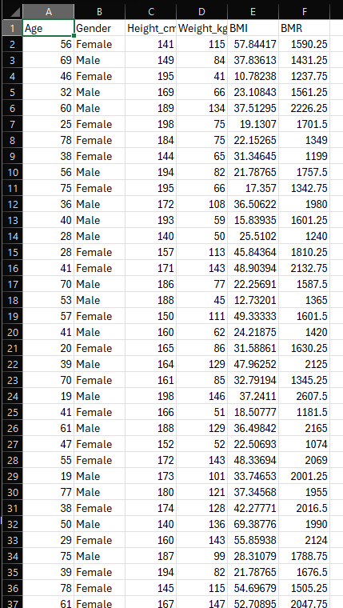
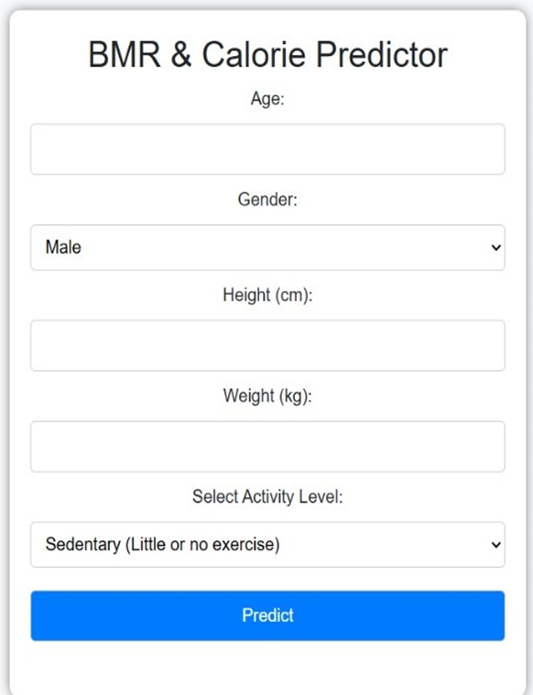
BMR AI
It calculates the BMR by predicting we calculate the accuracy = 0.95
True Positives =36
True Negatives = 59
False Positives = 2
False Negatives = 3
On training model: Gradient Boosting Regressor
With Mean absolute error = 27.04
and mean square error = 1073.31
And R² = 0.9909

Slide 28
System Architecture

Slide 29
System Architecture
Main page
Contact us
classes
trainer dashboard
shop
User dashboard
Admin dashboard
blog
login
BMR
spices
Sign up
Staff Login

Slide 30
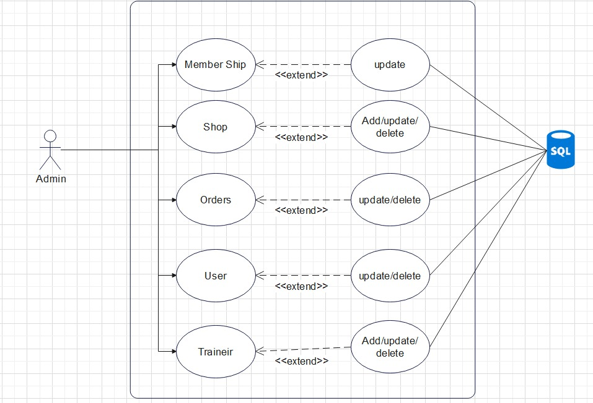
Admin Usecase

Slide 31
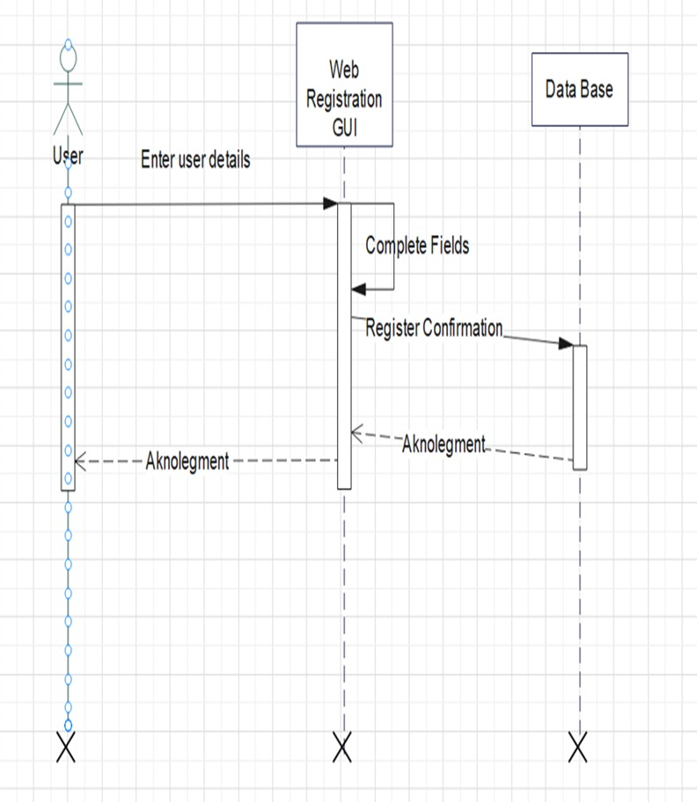
User Register

Slide 32
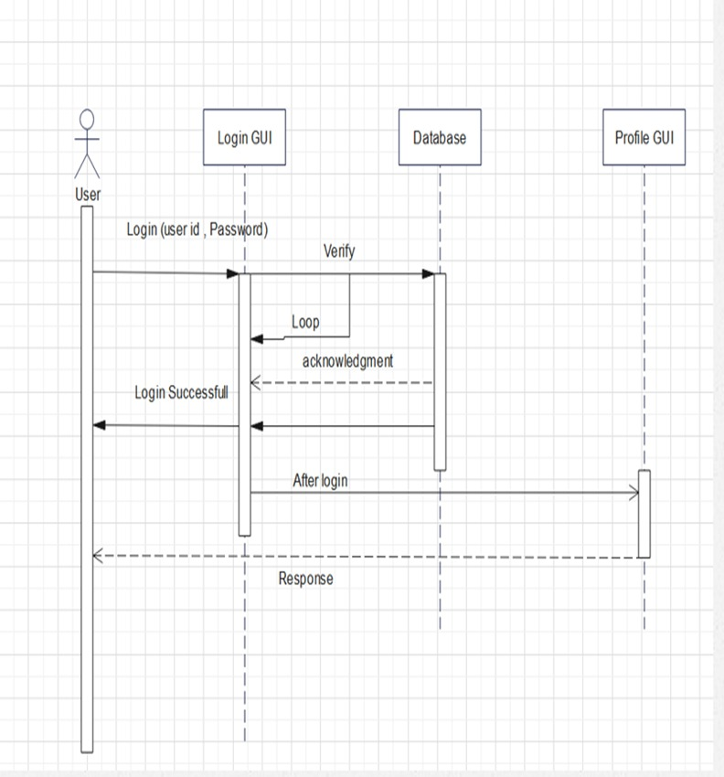
User Login

Slide 33
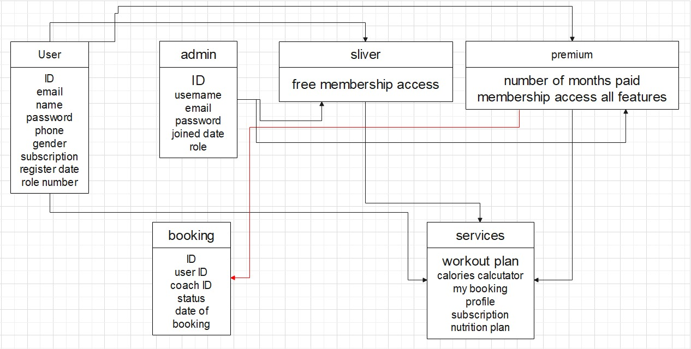
Entity-Relationship Diagram(ERD)

Slide 34
Demo

Slide 35
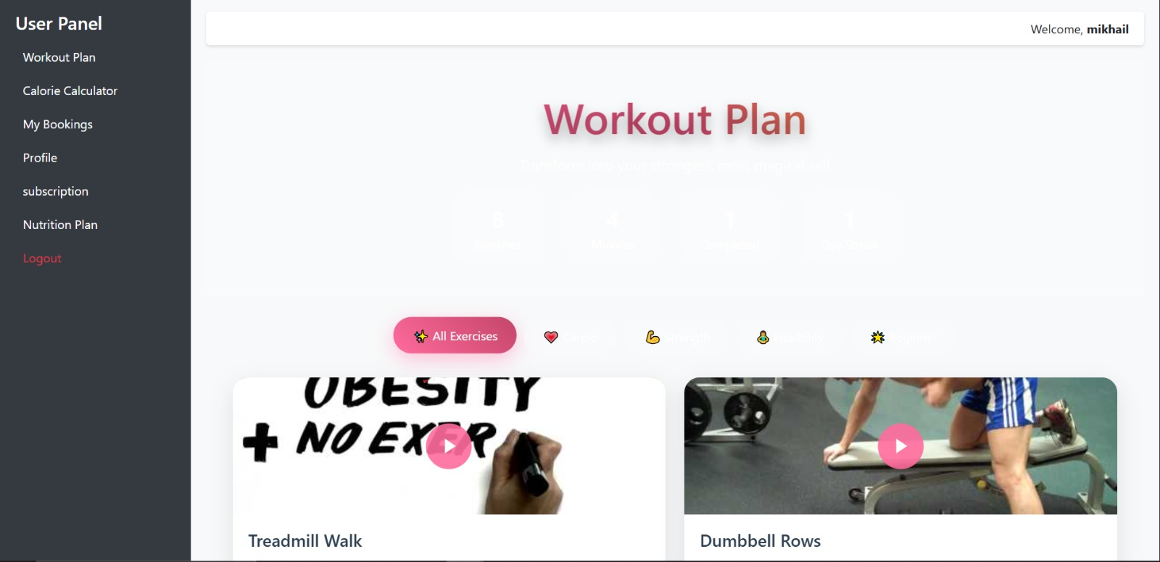
User Dashboard

Slide 36

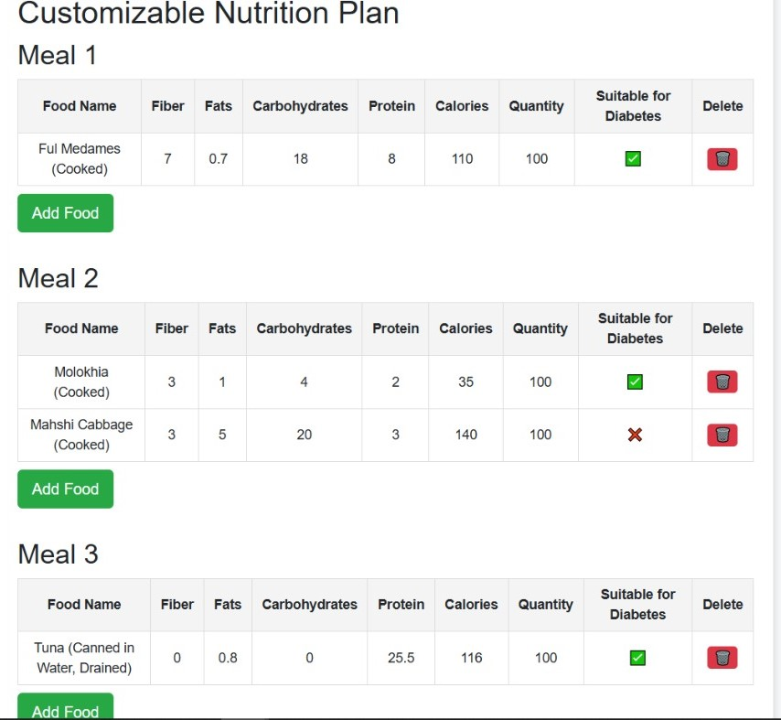
BMR & Nutrition

Slide 37
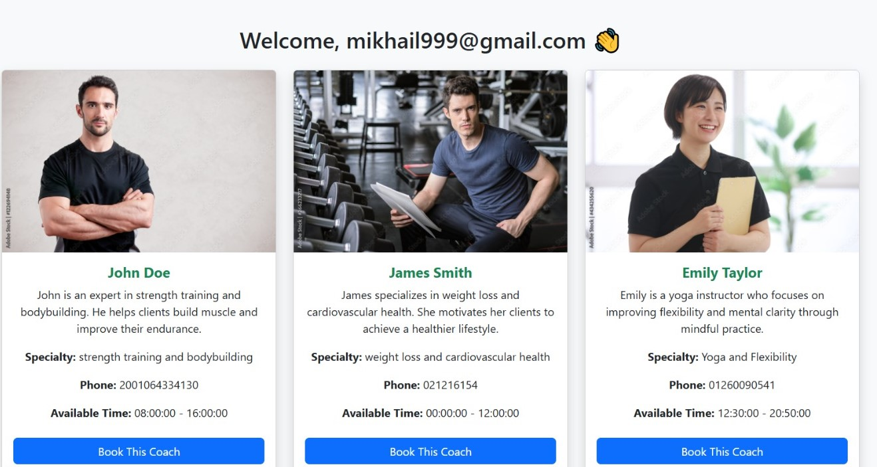
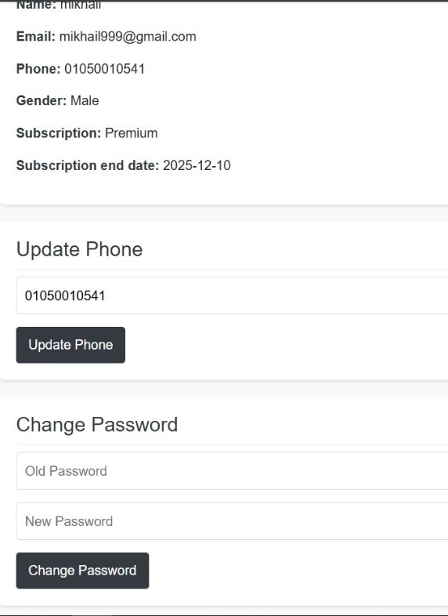
Booking & Profile

Slide 38
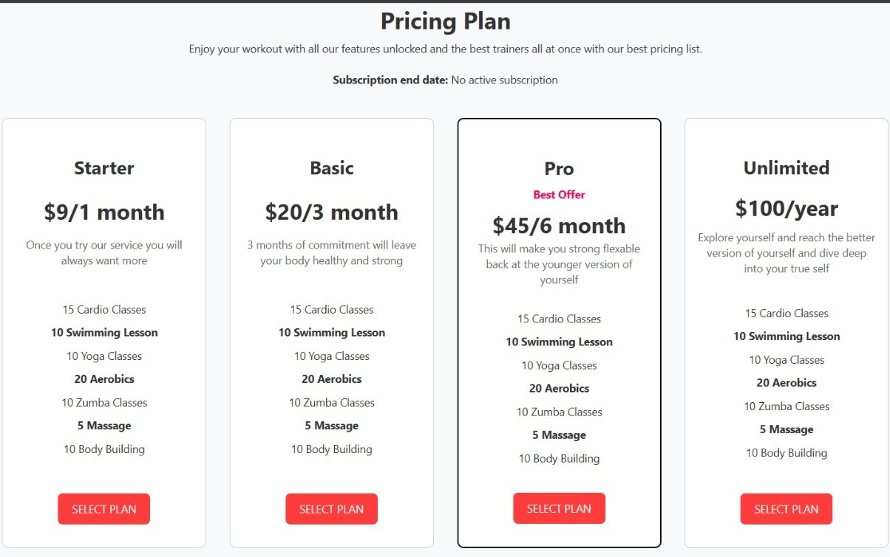
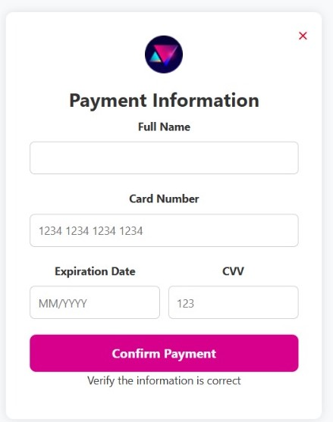
Pricing plan & Payment

Slide 39
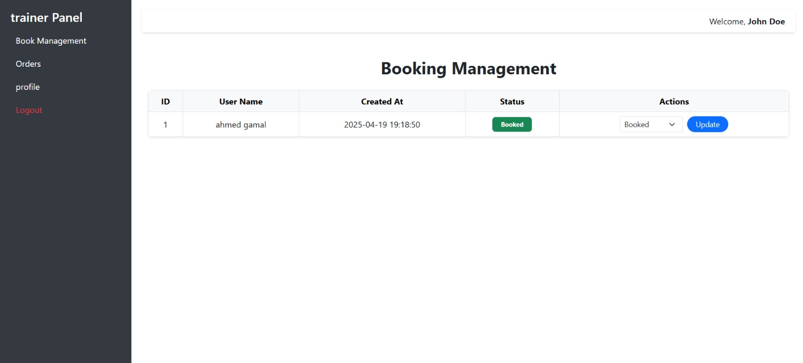
Trainer Dashboard

Slide 40
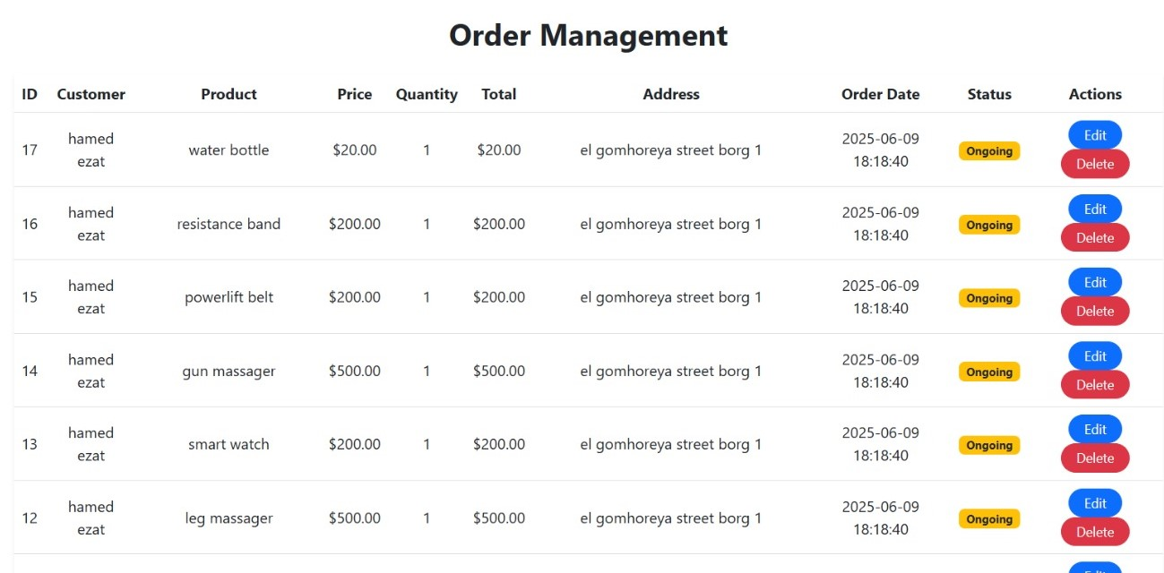
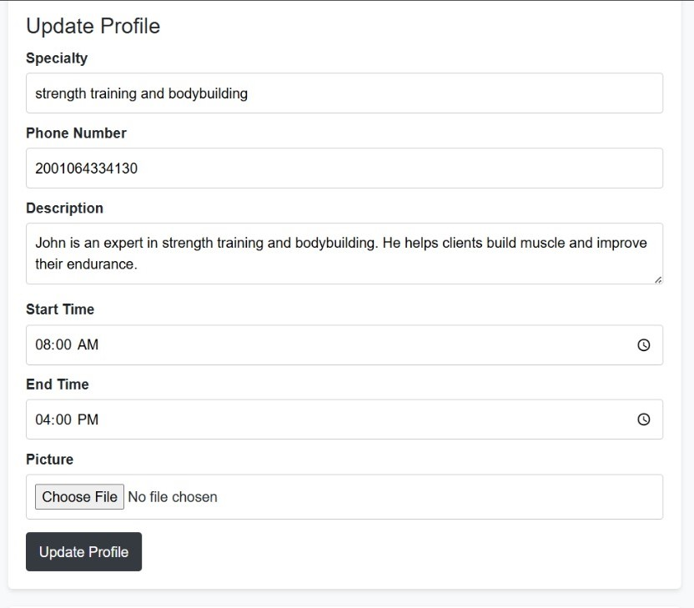
Order & Profile

Slide 41
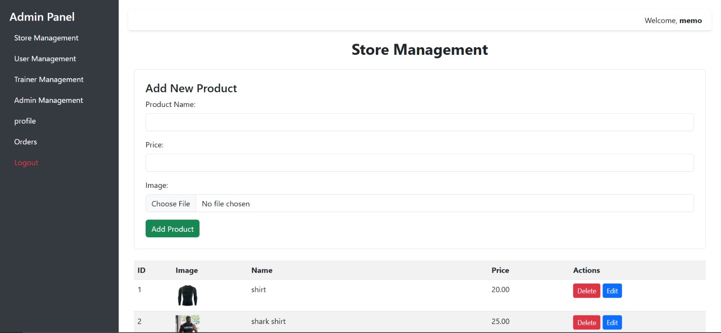
Admin Dashboard

Slide 42
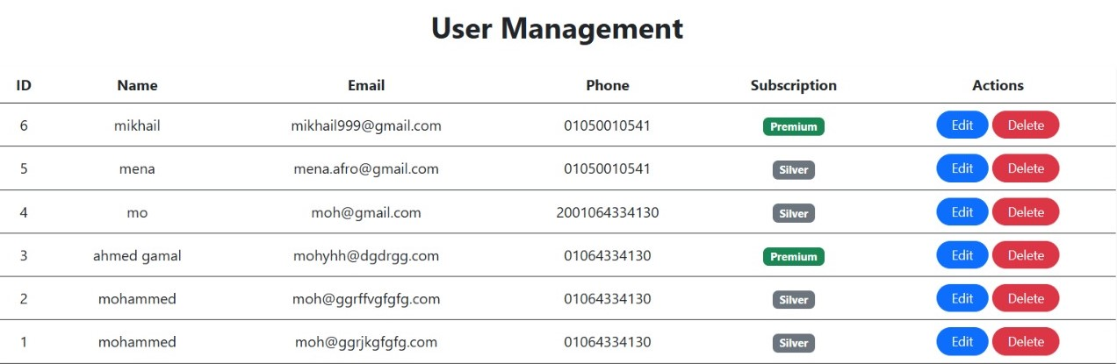
User Managment

Slide 43
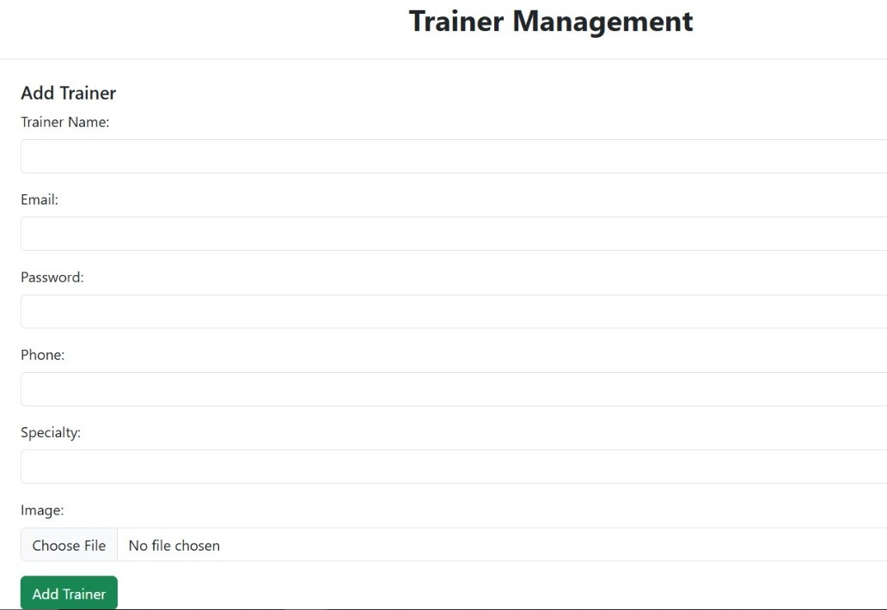
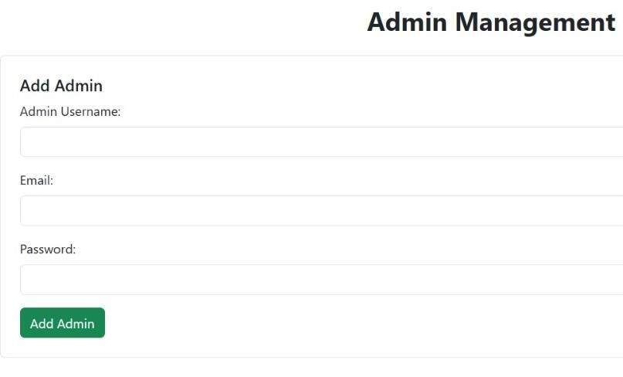
Trainer & Admin Management

Slide 44
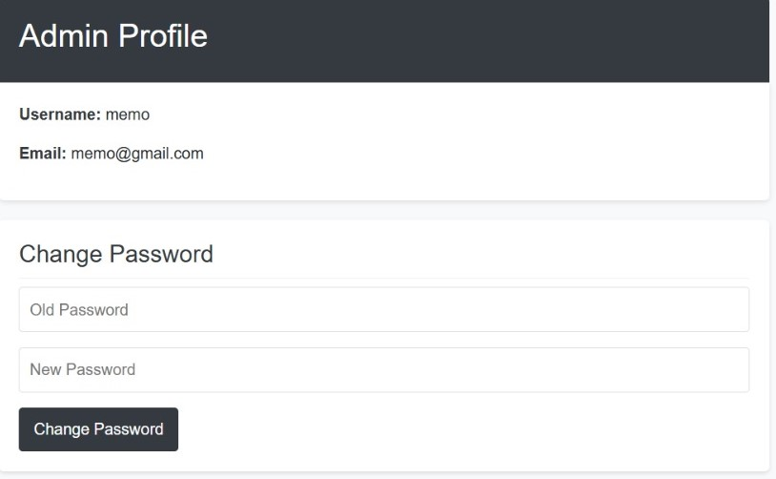
Profile & Orders

Slide 45
System Tools & Technologies

Slide 46
System Tools & Technologies
Front-End
HTML: For structuring the content.
CSS: For styling and layout.
JavaScript: For interactive and dynamic functionalities.
BootStrap: front-end framework For dynamic styling.
Back-End
PHP: For server-side logic, and validation.
MySQL: For database management.
Tools
Visual studio code
Phpmyadmin
Google chrome
Xampp

Slide 47
References

Slide 48
References
Gold’s gym: https://www.goldsgym.com/
EQUINOX: https://www.equinox.com/
الكوتش: https://www.elcoach.me/
BootStrap: https://www.muscleandstrength.com/
CENTR: https://centr.com/
Lose weight app: https://play.google.com/store/apps/details?id=menloseweight.loseweightappformen.weightlossformen&hl=en-US

Slide 49

Conclusion
The Fitness Club Gym Web Application provides solution for managing fitness journeys. It integrates workout plans, personal training, nutrition, online shop, into a single web application.

Slide 50

Thank you

